Slide 1
Lecture 5 – Inferential statistics and sampling processes
Pierre Walthery
Email: p.walthery@ucl.ac.uk

Slide 2
Last week:
Descriptive statistics – for continuous variables.
Measures of Central tendency.
Measures of dispersion.
Sampling and the sampling distribution
Standard errors
Confidence intervals
This week:
Notes:
2

Slide 3
SAMPLING
3

Slide 4
Sampling
What is sampling? Why sampling?
What is inference? What are inferential statistics?
What are the main types of sampling and what do they have in common?
Notes:
4

Slide 5
Sample, population and inference
We use sampling when we want to know ‘something’ usually a quantity about a population, but it is not feasible or too costly or slow to gather the information directly from all members of the population.
Population:
N = very big
Sample = the people surveyed
N = small
5
Notes:
5

Slide 6
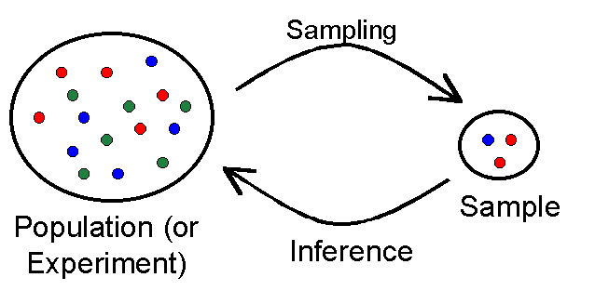
Inferential statistics
We call ‘inference’ generalisations we can make about things in the population from what we observe in our sample when certain conditions are met

Slide 7
Random vs non-random samples
A sample is said to be random if all observations from the population have an equal probability of being selected. This may sound simple to achieve in theory, less so in practice
Random samples provide in principle unbiased estimators that allow us to infer something about the population we are interested in (typically, a mean). In that sense random samples are representative of the population
Non random samples (whether by design or not) mean that some groups in the population will be under represented and others over represented. Estimators derived from such samples will be biased.
Size does not make samples representative as such

Slide 8
Variants of random samples
Simple random sample - e.g. the names of 25 employees being chosen out of a hat from a company of 250 employees
Advantages: simple to construct and use, and free from bias and prejudice.
Disadvantage: sometimes difficult to achieve especially if the population is large and there is not an easily accessible list of members (i.e. time, effort and money). E.g. difficult to contact sampled cases if they are widely dispersed.
A variant: Systematic sampling: members are selected according to a random starting, thereafter sampled according to a fixed, periodic interval. e.g. in a population of 10,000 people, every 100th person sampled.
- Advantages: easy/quick to implement
- Disadvantages: may incur bias, depending on the sampling frame

Slide 9
Multistage random sampling: stratified sampling
The sampling frame is divided into groups, based on shared characteristics. Random sampling is then undertaken within each group
E.g. For a study evaluating the political leanings of economics students, the list of students population is split by gender, whether undergraduates and graduate.
Advantages: Ensures each subgroup receives proper representation within the sample, especially those that are hard to reach, due to their size for other reasons and may be missed otherwise.
Disadvantages: Every member of the population needs to be identified in order to be each of them into one, and only one, subpopulation. Cannot use if this classification information is unknown.
9

Slide 10
Multistage random sampling: cluster sampling
As with stratified sampling, the sampling frame is gathered into groups.
First, groups are sampled randomly, rather than single cases.
During the second stage, group members are then sampled
All clusters have an equal chance of being selected.
By contrast with stratified sampling where all strata are retained only a number of clusters are sampled, all the other clusters are left unrepresented
Therefore clusters should be as diverse as possible whereas strata should be as homogeneous as possible
E.g. Geographical cluster. For example, a researcher wants to survey academic performance of high school students within different cities in Spain. Clustering is usually chosen to cut cost.
10

Slide 11
A real life sample: The Family Resources Survey
Like most real-life survey combine several types of sampling (ex: stratified (using census data) clustered sample)
Samples approx. 25k households per year (since 1993/4)
Uses the small–users Postcode Address File (PAF) as the sampling frame for Great Britain, a list of all addresses in the UK receiving fewer than 50 Items of post daily.
PAF only provides full address detail. No further information that might be useful for sampling, such as household composition or age structure of households.
The selection process ensures a particular household is not oversampled - to avoid complaints from members of the public being approached more than once for government surveys
11

Slide 12
Exercise 1: In pairs/small groups consider what types of sampling is used in the examples below: A) Simple Random Sampling? B) Stratified Random Sampling? C) Cluster Random Sample? D) None of these
A school chooses 333 randomly selected athletes from each of its sports teams to participate in a survey about athletics at the school
A researcher polls people as they walk by on the street.
A teacher puts students' names in a hat and chooses without looking to get a sample of 333 students.
A hospital wants to survey religious participants in their city about what they seek from a hospital chaplain, so they randomly select 555 religious meetings in the city and survey every participant in those meetings.
________ occurs when every member of a population has an equal chance of being selected for a sample.
If a researcher selected five schools at random and then interviewed each of the teachers in those five schools, the researcher used what type of sampling?
A researcher needs to determine the benefits of using a new algebra study technique. The researcher selected 50 beginning algebra students at random. The researcher selected 25 of these 50 students to participate in the new study programme.
12

Slide 13
What are samples used for?
We usually make inferences about some population mean(s) from the sample mean(s) using the theoretical properties of its sampling distribution.
Population
Empirical but unknown
These properties are derived from
the Central Limit Theorem
Sampling distribution (of the mean)
Sample mean
Empirical and known

Slide 14
Probability distributions – a reminder
A distribution represents the values a variable can take with their probability of occurrence: they can be empirical (ie as we observed them) or theoretical, described by an equation.
Things repeated over time or space can usually be described by a distribution ie the weight of adults in the UK, the number of car crashes at a particular junction, school leavers’ GCSE achievements
Distributions can be of two main types:
Parametric: they can be formally described by parameters (typically a mean and standard deviation, but there can be more/other ones)
Non parametric ( we won’t look at these in this module)
If we know the parameters of such distributions, we can then predict how likely we are to find given values of the mean

Slide 15
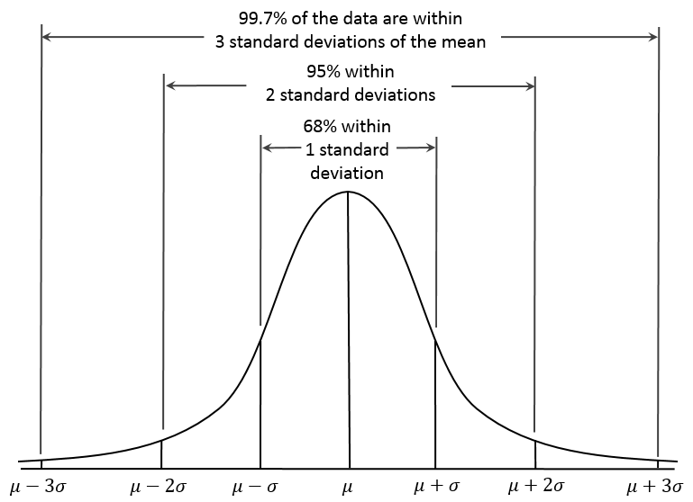
The normal distribution

Slide 16
What is the sampling distribution?
The sampling distribution is the theoretical distribution of the parameter we want to infer from the sample to the population.
Ex the mean number of minutes babies under two sleep at night
Note that the distribution of a parameter is not the same as the distribution of the original variable ie the distribution of the minutes babies sleep at night is not the same as the distribution of their mean across samples
We could visualise this empirically by drawing several samples of babies under two and plot their mean sleeping time on a graph .
The Central Limit Theorem tells us that if we were to draw lots of such samples, the mean of all of these would be the same as the population mean. The same is true of the standard deviation.

Slide 17
Central Limit Theorem
For large random samples repeatedly drawn from any population, the sampling distribution of the sample means (µ₁, µ₂, …, µ_{n}) will be approximately normally distributed.
No matter what the distribution of the original variable of interest looks like, as long as the sample is large enough, and all samples have the same size, you can assume normality of the distribution of the mean.
This allows us to predict how likely we are that a given value of the sample mean reflects the ‘true mean’ in the population
17

Slide 18
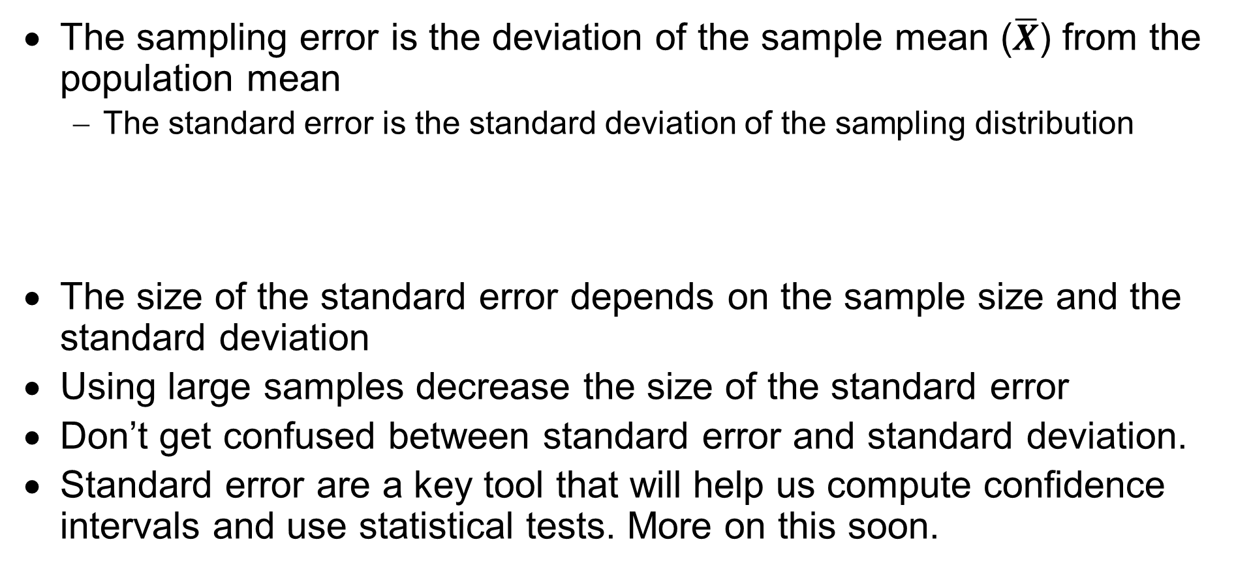
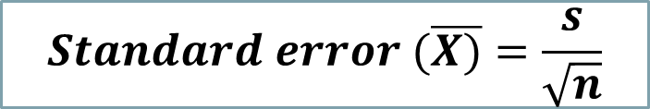
Sampling variation(error) and standard error
The sampling error is the deviation of the sample mean ($\overline{X}$) from the population mean
The standard error is the standard deviation of the sampling distribution
The size of the standard error depends on the sample size and the standard deviation
Using large samples decrease the size of the standard error
Don’t get confused between standard error and standard deviation.
Standard error are a key tool that will help us compute confidence intervals and use statistical tests. More on this soon.
$$Standard error (\overline{X)}=\frac{s}{\sqrt{n}}$$
Notes:
18

Slide 19
Statistical Inference – 1
CONFIDENCE INTERVALS
19

Slide 20
What is a confidence interval?
A CI is a range of values within which we are confident that the population mean lies, given the mean and standard deviation we have observed in our sample.
We express that confidence in terms of the level of certainty we want to have to be right
What levels are commonly used and what do they mean?
95% confidence level – in 95% of the cases, the population mean would lie between these values
99% confidence level
The more confident we want to be, the wider and therefore less precise the confidence interval
Notes:
20

Slide 21

Computing a confidence interval
We know that the sampling distribution of the sample mean is normal, and we also know its standard error
A CI around the mean is computed by multiplying the standard error (the typical deviation of the sample mean from the population mean) by the z, the confidence coefficient derived from the confidence level we are choosing (ie 95%, 99%)
$$CI (\overline{X)}=\overline{X}±z SE$$
Confidence coefficient | z
68% | 1.00
95% | 1.96
99% | 2.58
99.9% | 3.29

Slide 22
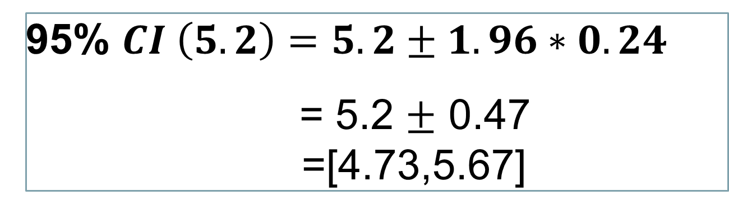
Computing a confidence interval
We know that the mean number of close friends of respondents to a survey is 5.2, and the standard error 0.24. What is the 95% confidence interval for the population mean?
Using the table from the previous slides, we can replace the numbers in the formula:
95% $CI \left(5.2\right)=5.2±1.96∗0.24$
= 5.2 $±$ 0.47
=[4.73,5.67]

Slide 23

Confidence intervals in Stata
The command in Stata:
ci means var
Example: Mean and 95% CI for number of close friends
command
variable
the statistic for which you want the CI
We are 95% confident that the average number of close friends is between 5.16 and 5.25.
You can also calculate confidence intervals around other statistics, such as proportions, variances, and standard deviations (in Stata: replace ‘means’ by ‘proportions’ ‘variances’ or ‘variances, sd’)
23
Notes:
23

Slide 24
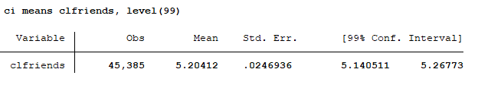
Confidence intervals at other confidence levels:
The command in Stata:
ci means var, level (99)
Example: Mean and 99% CI for number of close friends
command
variable
confidence level
the statistic for which you want the CI
How would we interpret this?
24
Notes:
24

Slide 25
How do we interpret this
The narrower the confidence intervals, the more straightforward their interpretation. Wide confidence intervals do not carry out much meaning
The size of the confidence interval depends on:
The size of our sample
Its dispersion
The confidence level we want to have
CI provide information not only about
Confidence intervals are sometimes preferred to hypothesis testing as they are more informational than hypothesis testing

Slide 26
STANDARDISING SCORES
26

Slide 27
Standardising scores
Why standardize scores?
How can scores be standardized? (Z scores)
How can we calculate z scores? (For a sample value. subtract the mean and divide by the SD; note the sign +/-)
What does a standardized score look like?
Notes:
27

Slide 28
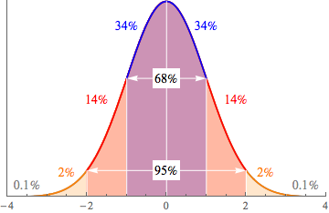
Z-score distribution: 95% of data fall within 2 SD of the mean
Notes:
28

Slide 29
An example:
Two undergraduate friends argue about who did better in their subject exam.
Claire obtained 65% in Politics
Joe obtained 60% in Economics
To resolve the issue, we need to know how the other students doing those subjects performed
Politics: mean = 60, standard deviation = 5
Economics: mean = 50, standard deviation = 6
Notes:
29

Slide 30
Interpreting positive and negative Z scores
If a Z-Score has a Positive Value…This means that it is above the group mean.
For example, a z-score, 0.64 and an exam score of 89%. Because the z-score is positive, we can conclude that the exam score of 89% is above the group mean. This means that the person who scored a 89% performed better than average.
If a Z-Score has a Negative Value…This means that it is below the group mean.
For example, a z-score of -0.65 and an exam score of 70%. Because the z-score is negative, we can conclude that the exam score of 70% is below the group mean. This means that the person who scored a 70% performed less than average.
30

Slide 31
Exercise 1: A student is trying to decide which subject to continue studying after her first general year at university. Based on her relative performance in her end of year exams which subject should she choose?
Sociology = 75% mean class score=65, sd=5
Economics = 80% mean class score=75, sd=7
Psychology = 70% mean class score=68, sd=2
31

Slide 32
Solution
The student scored 2 sd above the mean in sociology, .7 in economics and 1 in psychology.
She should take sociology if she is basing her decision on her relative performance in her exams only.
32

Slide 33
Next week
Hypothesis testing. This week you will learn how to test whether the differences you are seeing when you compare groups in data are genuine. You will learn how to construct a hypothesis, how to test it using different tests depending on the data you are looking at (including t-tests; ANOVA; chi-square) and be introduced to the concept of statistical significance and p-values.
Another Quiz!
33

